Slide 1
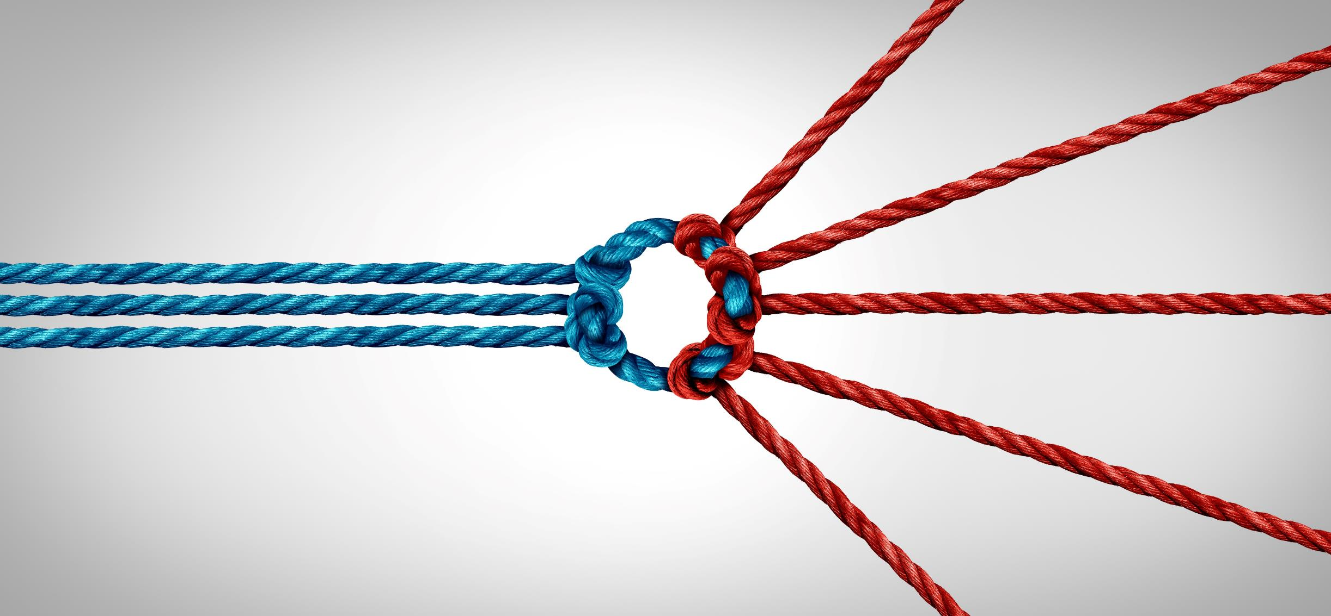
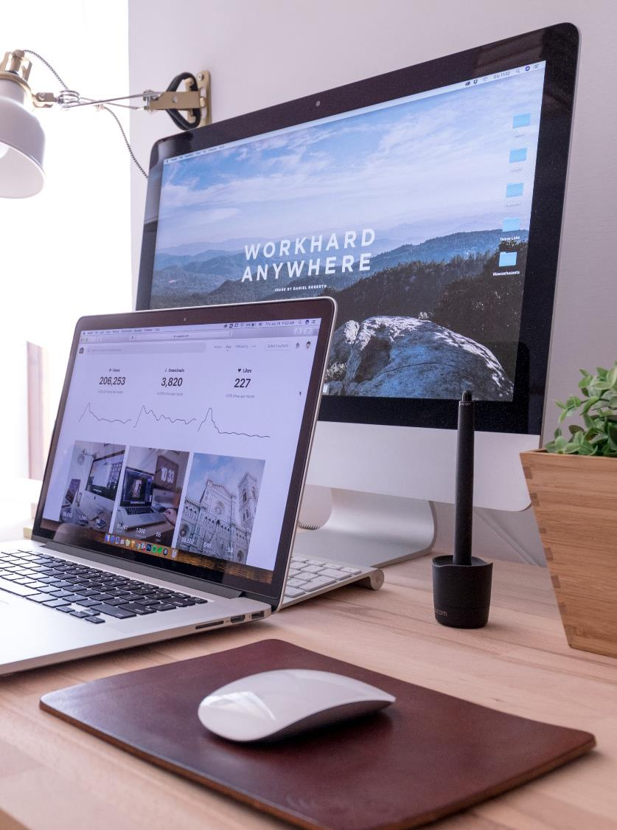
THE ART OF DOING
Micro moves
To achieve
Macro impact IN
digital marketing
WWW.FABLESQUARE.COM

Slide 2
ABOUT
FABLESQUARE
FableSquare is a premier digital marketing and website design agency.
We use tried and true digital marketing strategies to generate high-quality leads and drive conversions for your business.
320+
CLIENTS
1000+
PROJECTS
9+
YEARS

Slide 3
Micro moves
Macro impact
Micro Moves are subtle actions or activities.
Macro Outcomes are impactful, measurable results.
20% work
80% RESULT

Slide 4
Pull Marketing
Website Design
Push Marketing
SEO (Organic)
SEM (Digital Ads)
Mobile First, Dynamic, Engaging
Social Media Marketing Digital Advertising

Slide 5
INTEGRATED
MARKETING
PULL
MARKETING
PUSH
MARKETING
Google Ads
Website
Facebook
SEO
LinkedIn
Blogs
Instagram

Slide 6
Micro
moves
Ad Campaigns
Website
Google MyBusiness
Well Thought Proposal
Blogs and Articles
Ad Campaigns

Slide 7
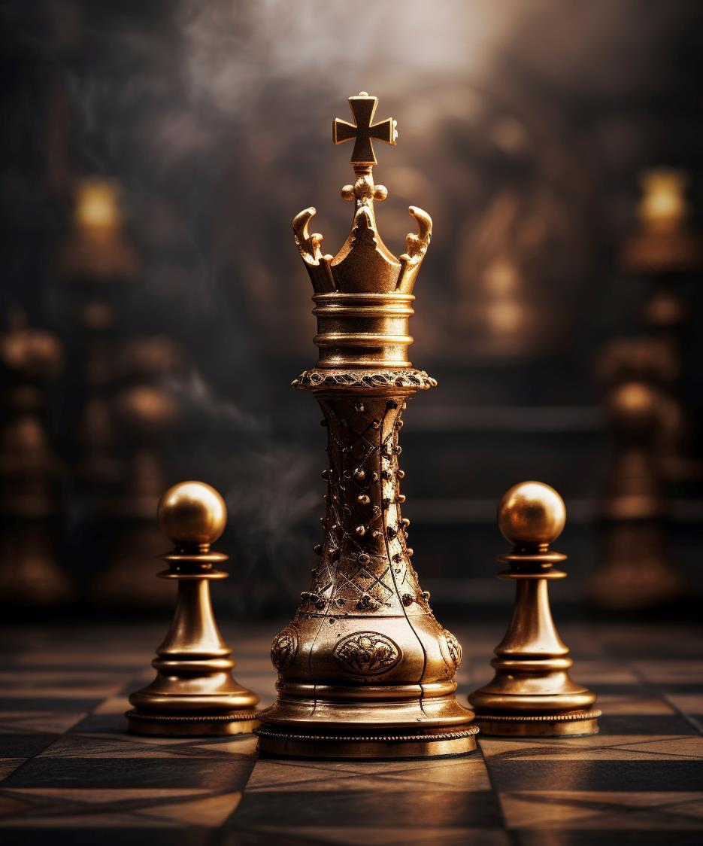
Macro
Outcomes
Brand
Awareness
Website Visits
Mayur Bhat
Co - Founder
Increased
Leads
Improved
Sales

Slide 8
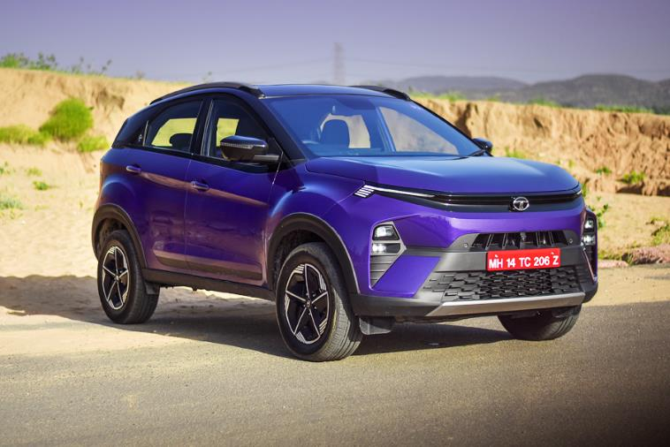
Maruti Suzuki Baleno : Rs6.61 - Rs9.88 lakh
Mayur Bhat
Co - Founder
Tata Nexon: Rs8.10- Rs15.50 lakh

Slide 9
HAVE YOU
INVESTED
ON YOUR
DIGITAL
IDENTITY?
Mayur Bhat
Co - Founder

Slide 10
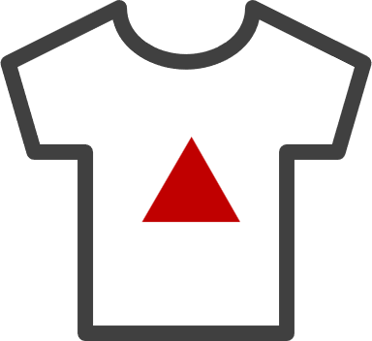
WEBSITE
DESIGN
People Find You Through Search Engines
People Find You Through Google MyBusiness
People Find You Through References
Business
Website
Ad Landing
Pages
Ecommerce/Product
Website

Slide 11
WHY
INVEST ON WEBSITE
1
83% of Purchase Decisions Involve a Website Visit
2
Your Competition is Leveraging Websites
3
24x7 Salesperson – It works even when you sleep
4
A website starts a conversation even before you meet your customer

Slide 12
WEBSITE FEATURES
SEO Friendly
Responsive
Analytics
Integrations
Custom Design Style
Multi-page Website
Video & Animations

Slide 13
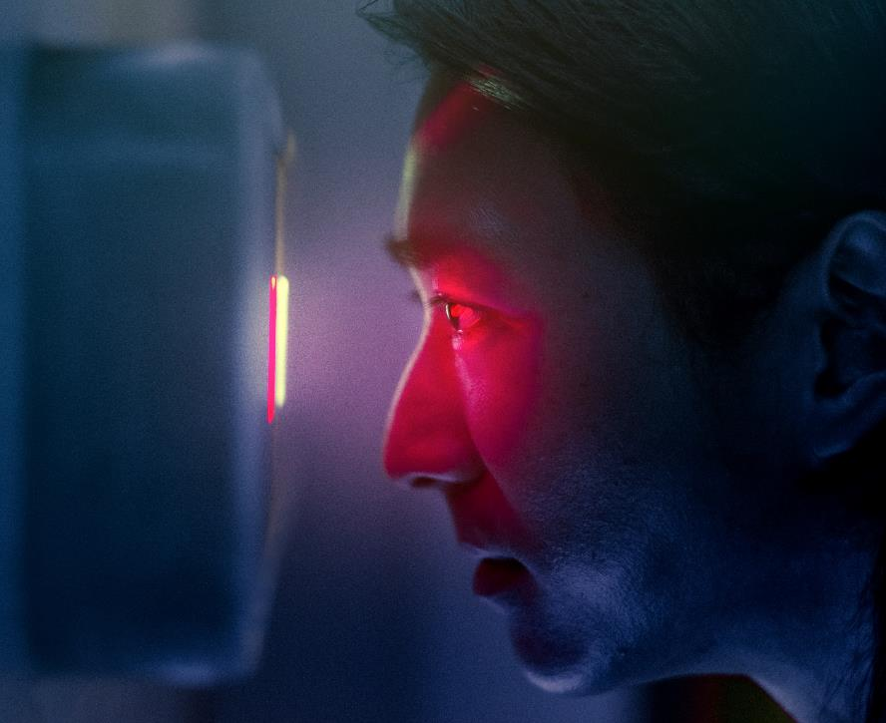
PULL
MARKETING
When do people use Google?
When there is a need / problem they want to solve
When they need information
What to Focus On?
Appear on The First Page of Google Search
for the Right Keywords, with SEO and Digital Ads
What does it do for you?
Makes you findable
Makes sales easier
Edge Past your competitors

Slide 14
PULL
MARKETING
Pull marketing, or inbound marketing, is where businesses aim to attract customers towards their products or services.
Benefits:
Focus Areas:
Customer Engagement
Content Creation
Cost-Effective
SEO (Search Engine Optimization)
Authenticity
Customer Feedback and Reviews
Data Driven
User-Friendly Website
Long-Term Impact
User-Friendly Website
User-Friendly Website
User-Friendly Website
User-Friendly Website
User-Friendly Website

Slide 15
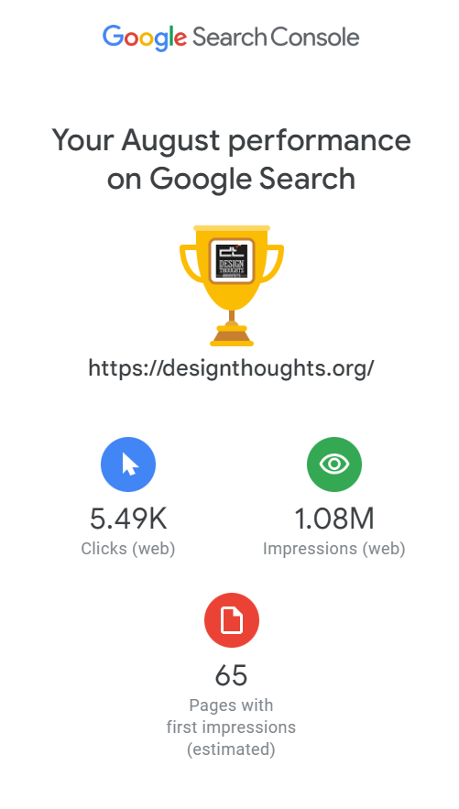
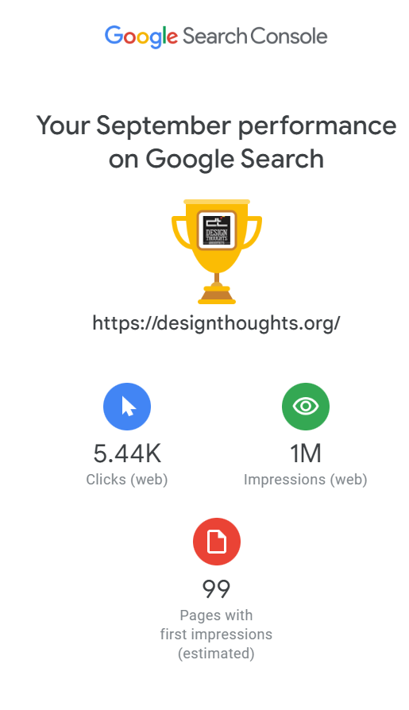
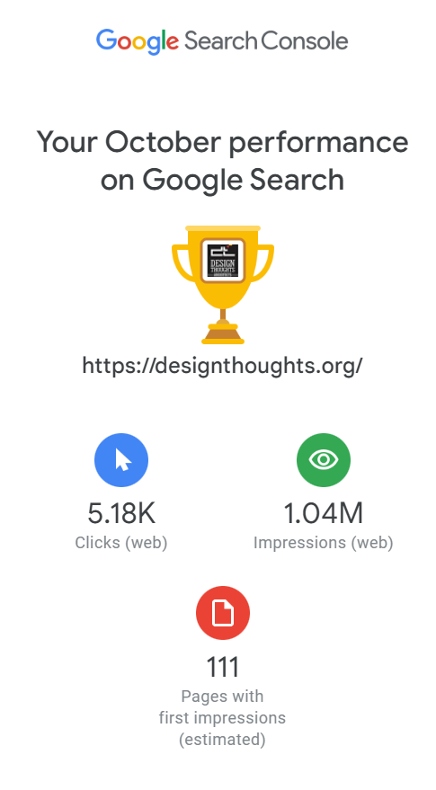
Mayur Bhat
Co - Founder

Slide 16
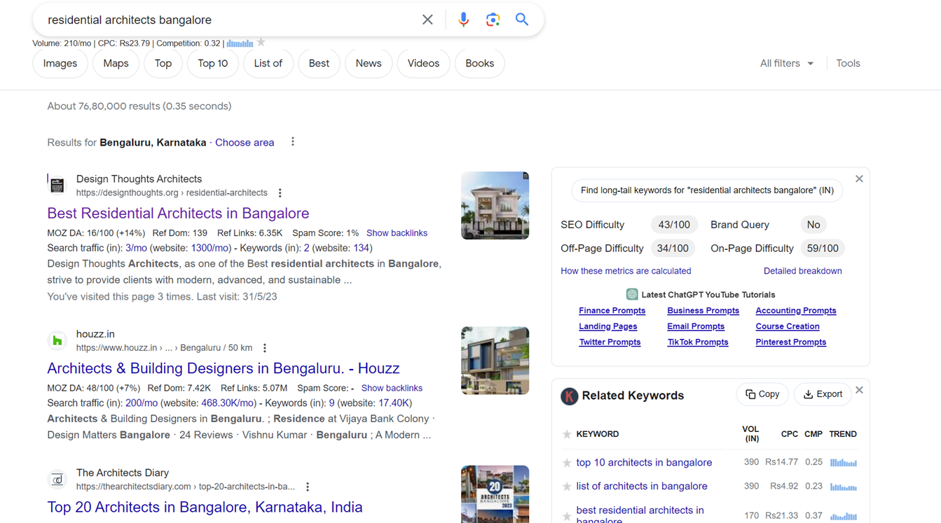
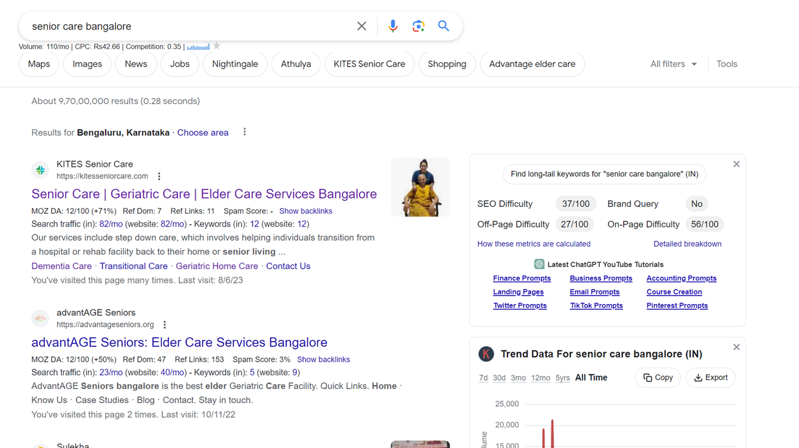
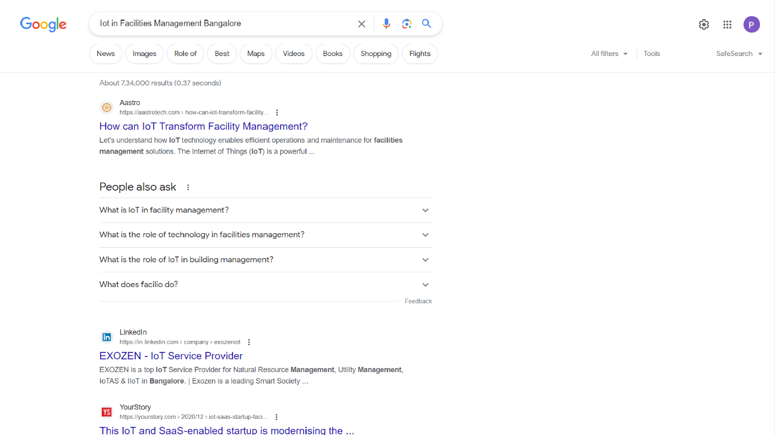
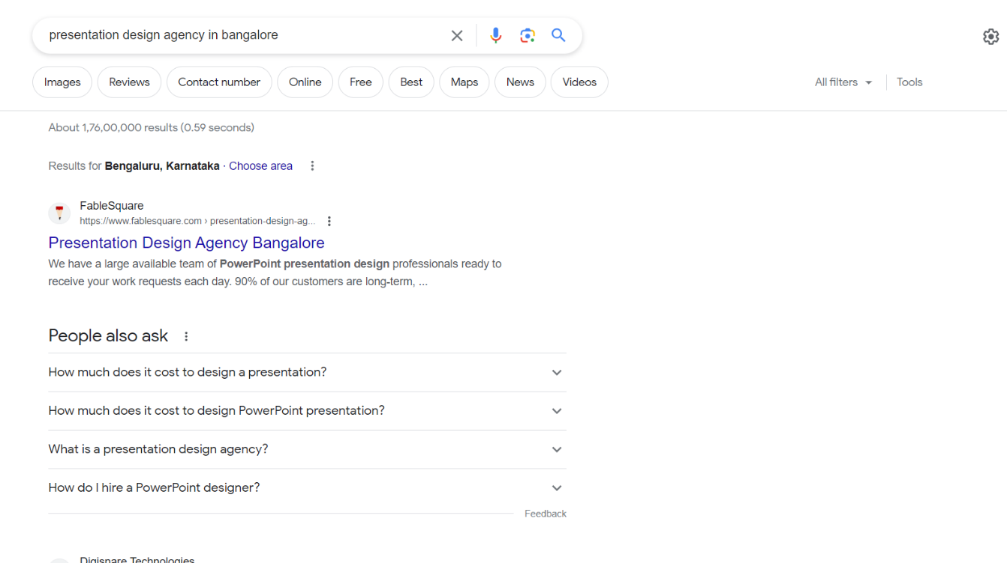
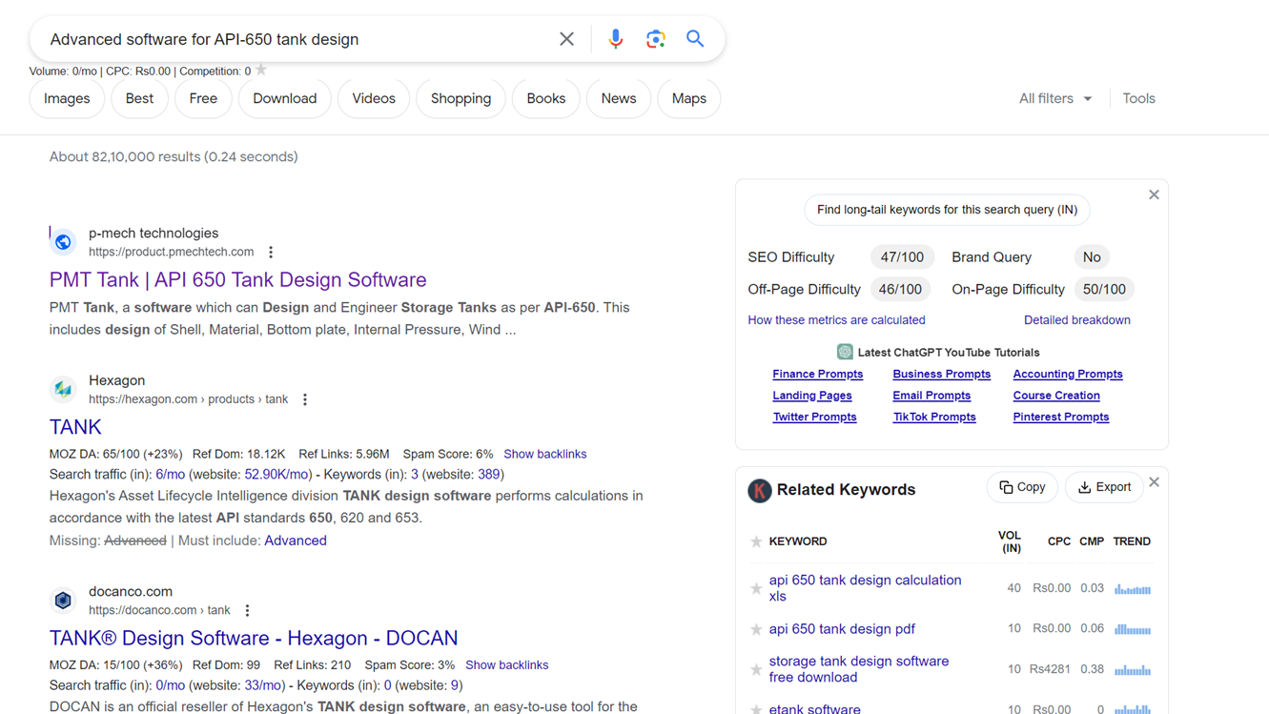
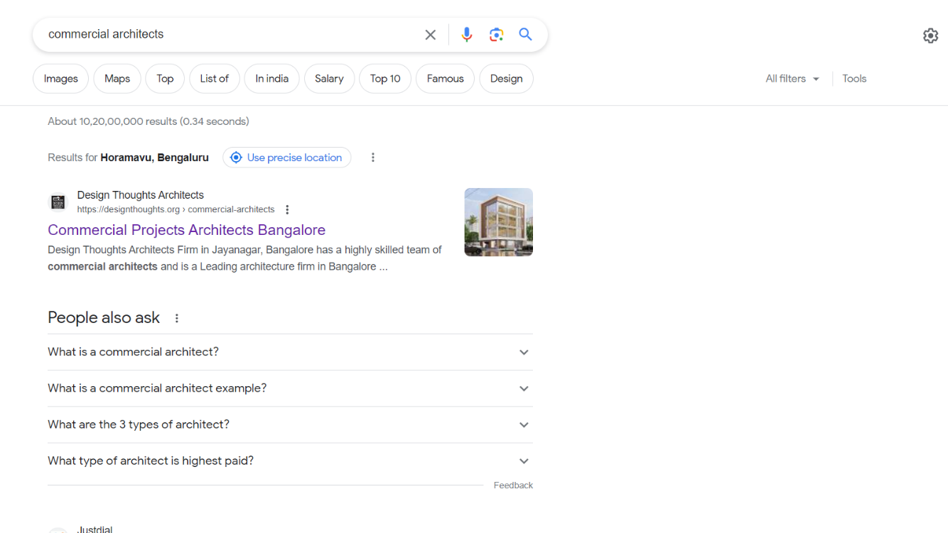
SEO ShowCase

Slide 17
PUSH
MARKETING
Social Media Marketing
Organic Social Media – Followers, Hash Tags
Paid Social Media (Ads) – Audience Targeting
What to focus on?
Reach people who are most likely to purchase your product / service or follow your content
Target people based on demographics, psychographics, behaviour, interests, purchase intent

Slide 18
PUSH
MARKETING
Push marketing, or outbound marketing, involves businesses actively promoting your products or services to a wide audience.
Benefits:
Focus Areas:
Quicker Results
Advertising Campaigns
Controlled Messaging
Sales Promotions
Broad Reach
Outreach Programs
Direct Sales Impact
Trade Shows and Events
Quick Results
Email Blasts

Slide 19
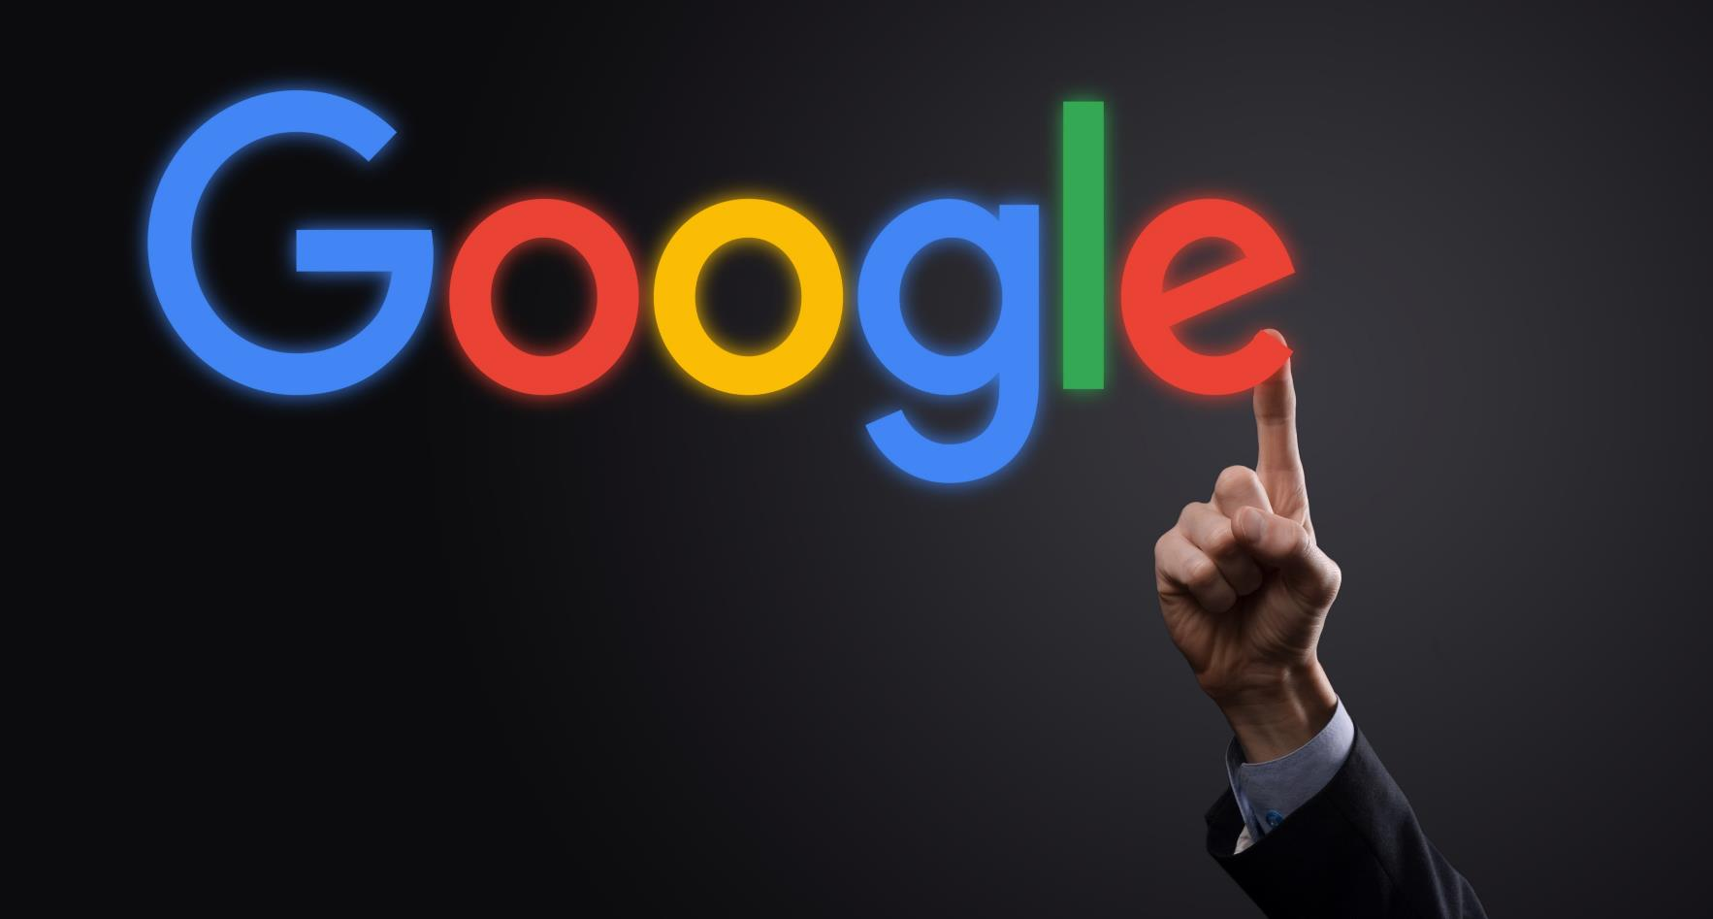
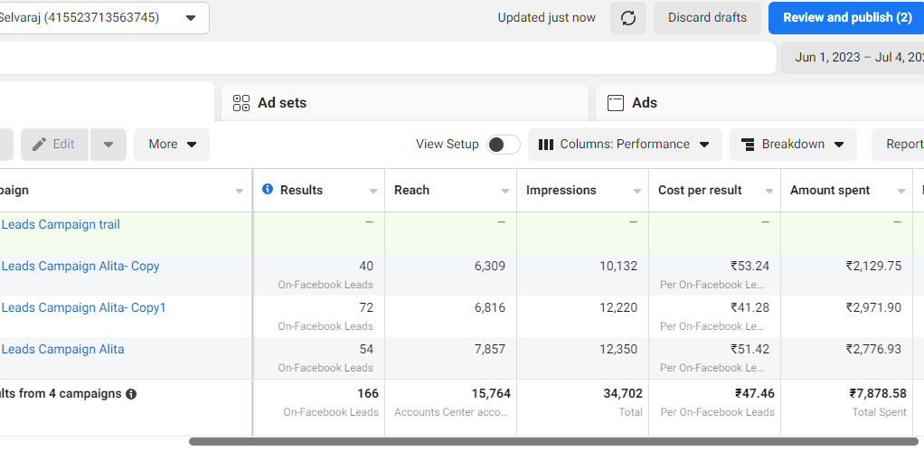
ADS & RESULTS
Time Frame = 3 Days | Leads = 166 |

Slide 20
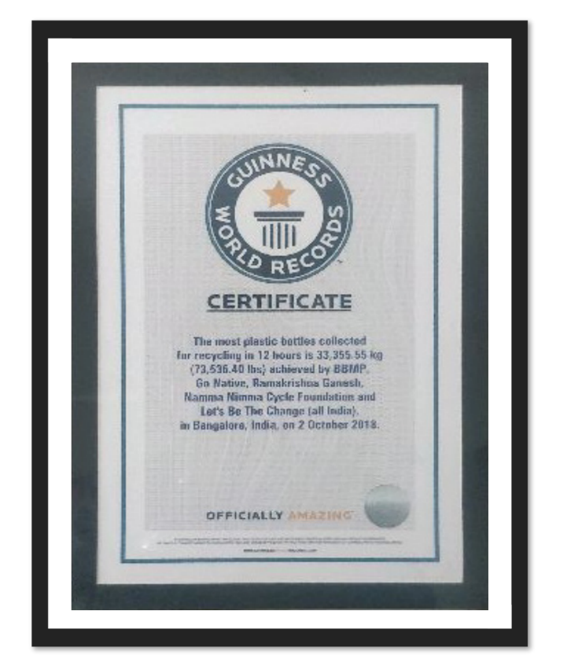
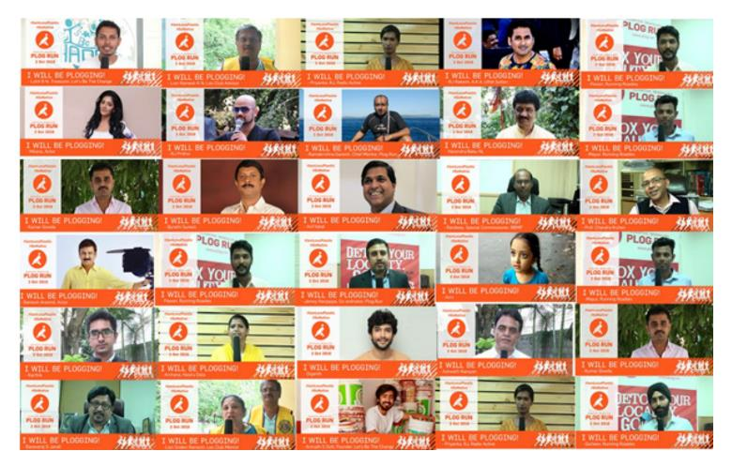
WEBSITE
FUNCTIONs
Unique functionality is a broad as a concept.
This can be anything from front-end design functions, such as having animations on buttons or icons, to ecommerce functionality, opt-ins and popups etc.
A simple explanation is, the more functionalities you need the site to perform, the more the investment into the website.
Time Frame = 14 Days | Leads = 7000 Attendees |

Slide 21
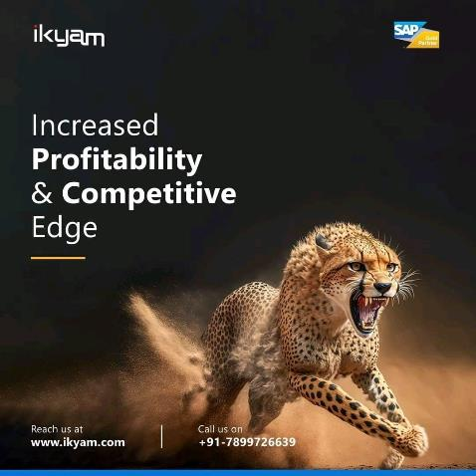
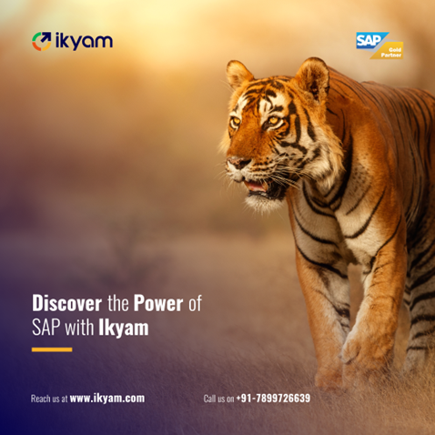
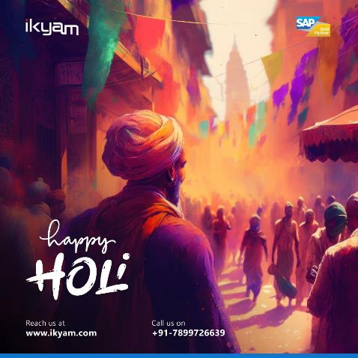
Social media posts
Unique functionality is a broad as a concept.
This can be anything from front-end design functions, such as having animations on buttons or icons, to ecommerce functionality, opt-ins and popups etc.
A simple explanation is, the more functionalities you need the site to perform, the more the investment into the website.

Slide 22
10 Commandments of Digital Marketing

Slide 23
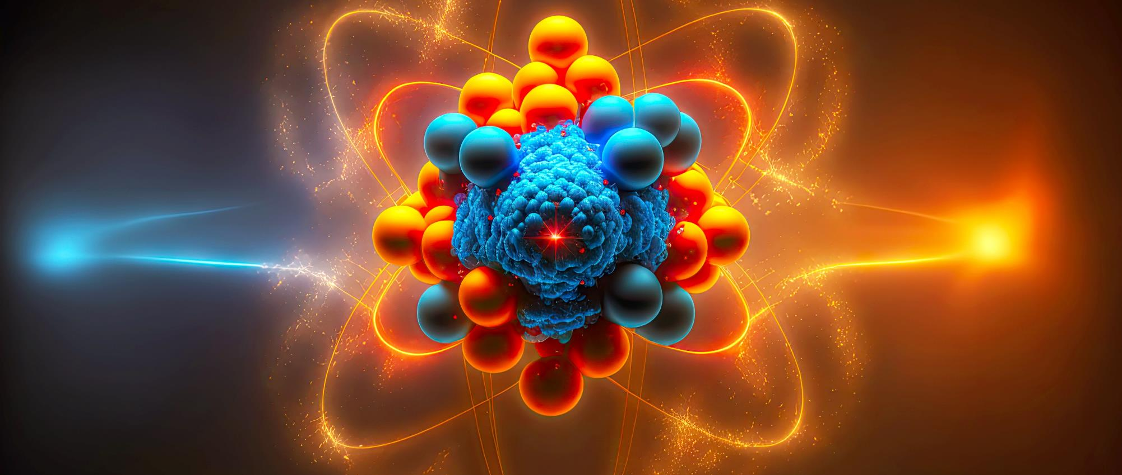
1. Your WEBSITE IS YOUR CORE, NOT JUST A CHECK MARK
Tell the story
as it should be
Well-formatted communication – Inform, Educate, Attract
Allows multiple means of communication – Content, Video, Images….

Slide 24
2. OPTIMIZE FOR
MOBILE
1
Over 80% of web traffic comes from mobile users
2
Better Ranking When Optimized
3
Improved User Experience​
4
Better Conversion Rates​

Slide 25
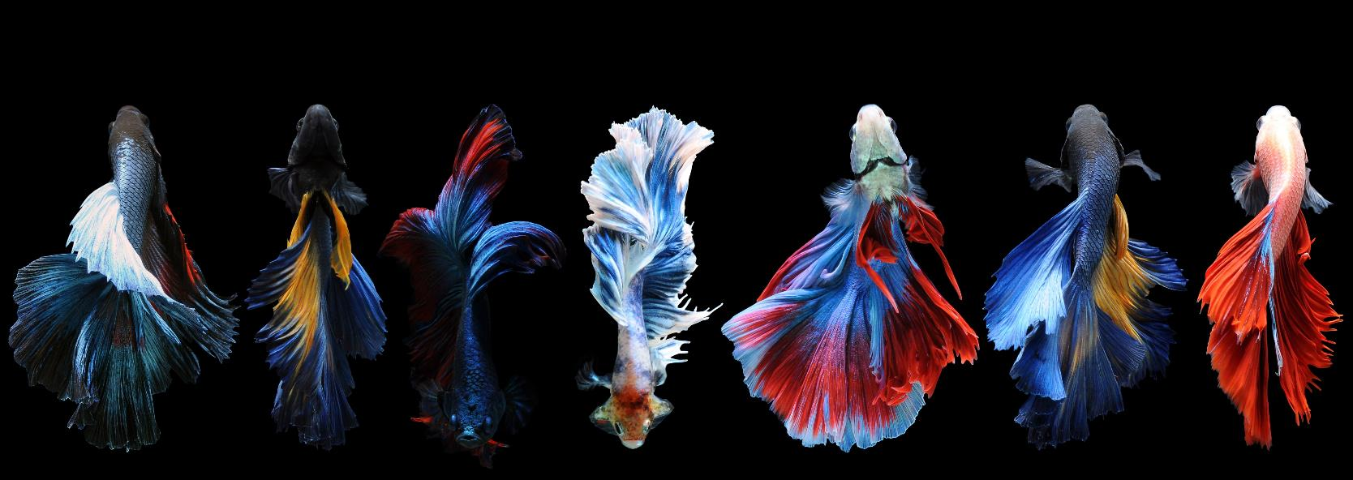
3. THERE IS MORE THAN JUST ONE SEARCH ENGINE
Did you know that YouTube is the second largest search engine after Google?
Try multi-format marketing: YouTube, Pinterest.....
Remember Other Search Engines

Slide 26
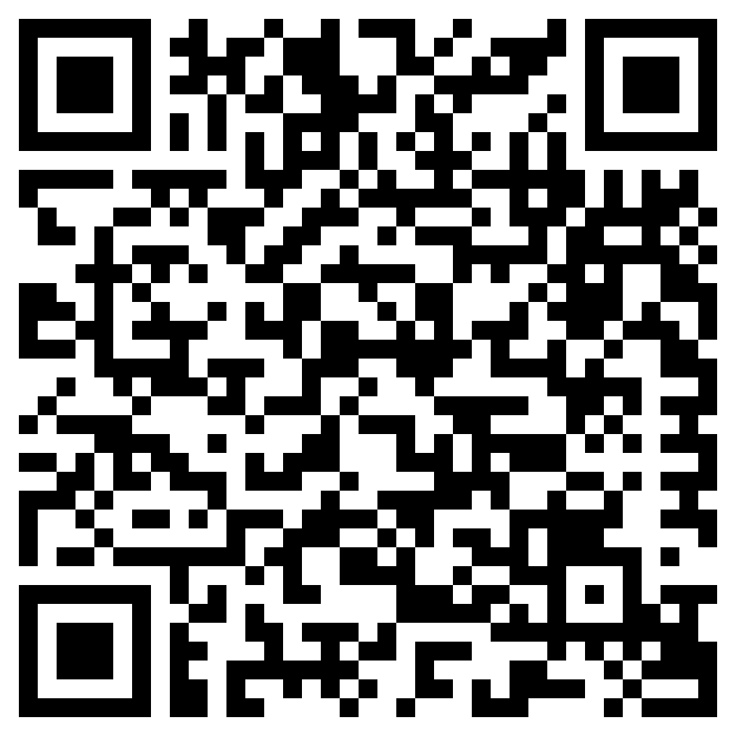
Top 10
Search Engines
Google: The Global Leader
Bing: Beyond Basics
Yahoo: Loyal Following
Baidu: China's Dominance
Yandex: Russia's Search Champion
DuckDuckGo: Privacy Advocate
Ask.com: Natural Language Focus
AOL Search: Familiar Face
Naver: South Korea's Search Leader
Ecosia: Searching with Purpose

Slide 27
4. FOCUS ON LOCAL SEO
GOOGLE MY BUSINESS
1
Optimize your business profile on Google
2
Tackle your vicinity and reduce competition​
3
Gain low-competition, high relevance leads
4
Social proof and testimonials ​

Slide 28
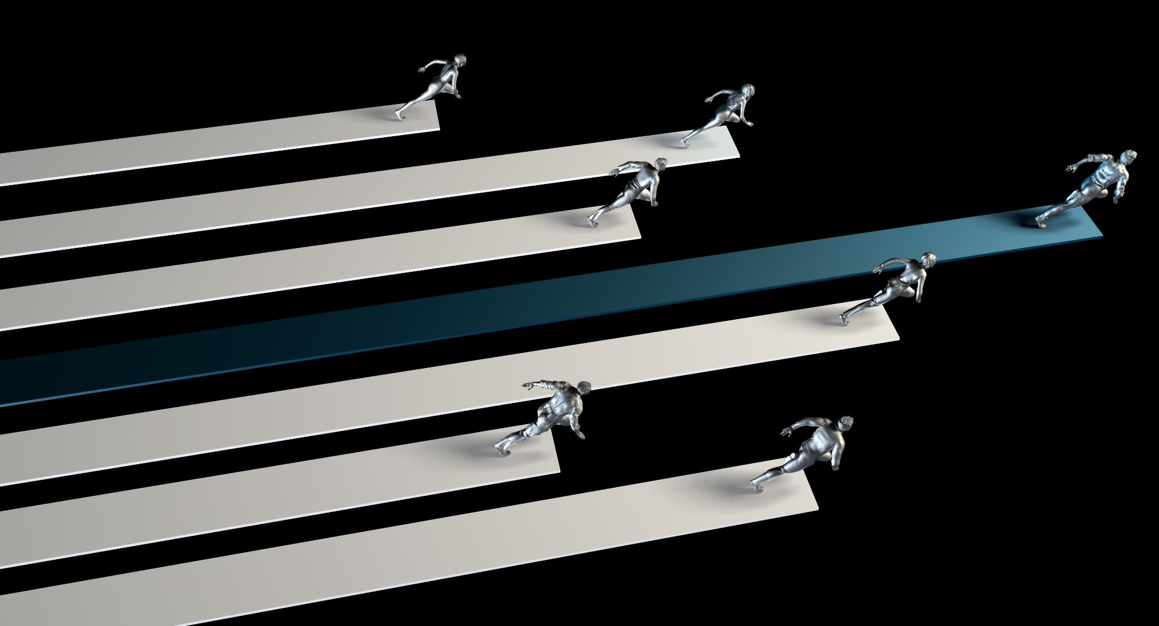
5. SEO is
MARATHON
NOT A SPRINT ​​
1
More time = More advantage ​
2
Tackle your vicinity and reduce competition​
3
Gain insights into local search performance ​
4
Social proof and testimonials ​

Slide 29
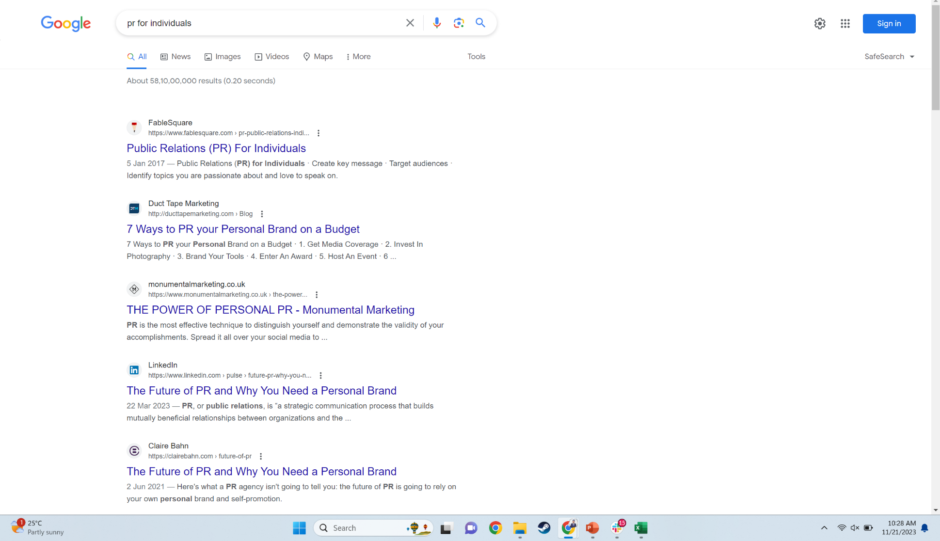

Slide 30
6. LONG TAIL WINS IN
THE LONG RUN
DON’T JUST GO FOR PRIMARY KEYWORDS​
1
Specific is terrific​
2
Reflect more specific user intent​
3
Faster to first page on searches for specific keywords​
4
Long tail keywords ensures the optimization appears in specific searches​
5
Less competition for niche phrases.​

Slide 31
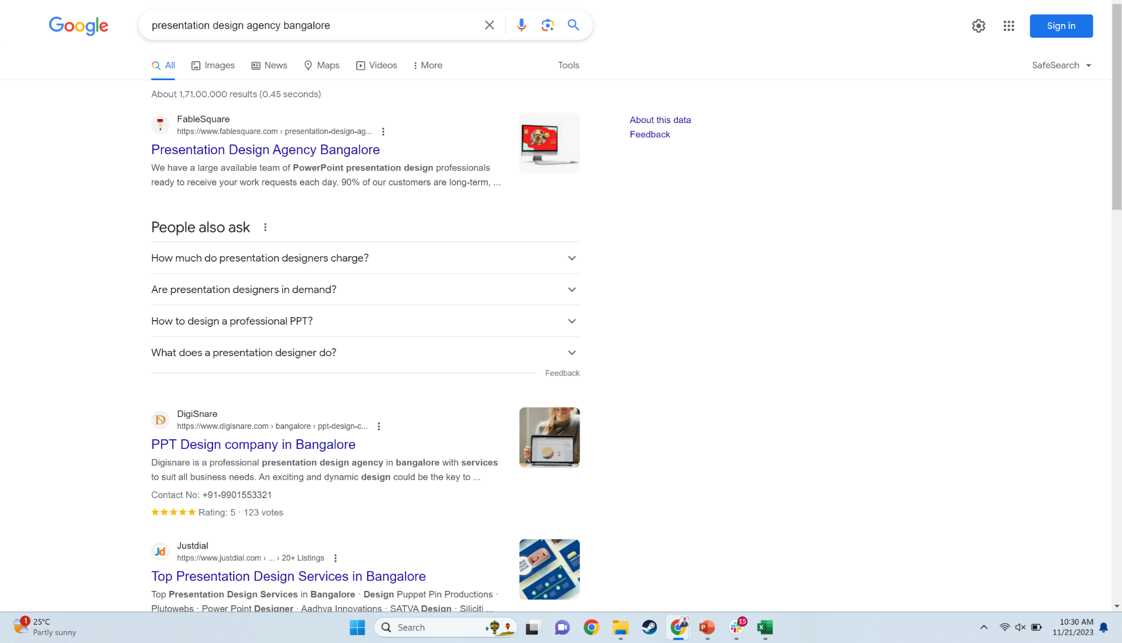

Slide 32
7. OPTIMIZATION IS MORE THAN JUST ABOUT CONTENT
Focus on Design & Experience
Focus on Technical
Focus on Image & Video

Slide 33
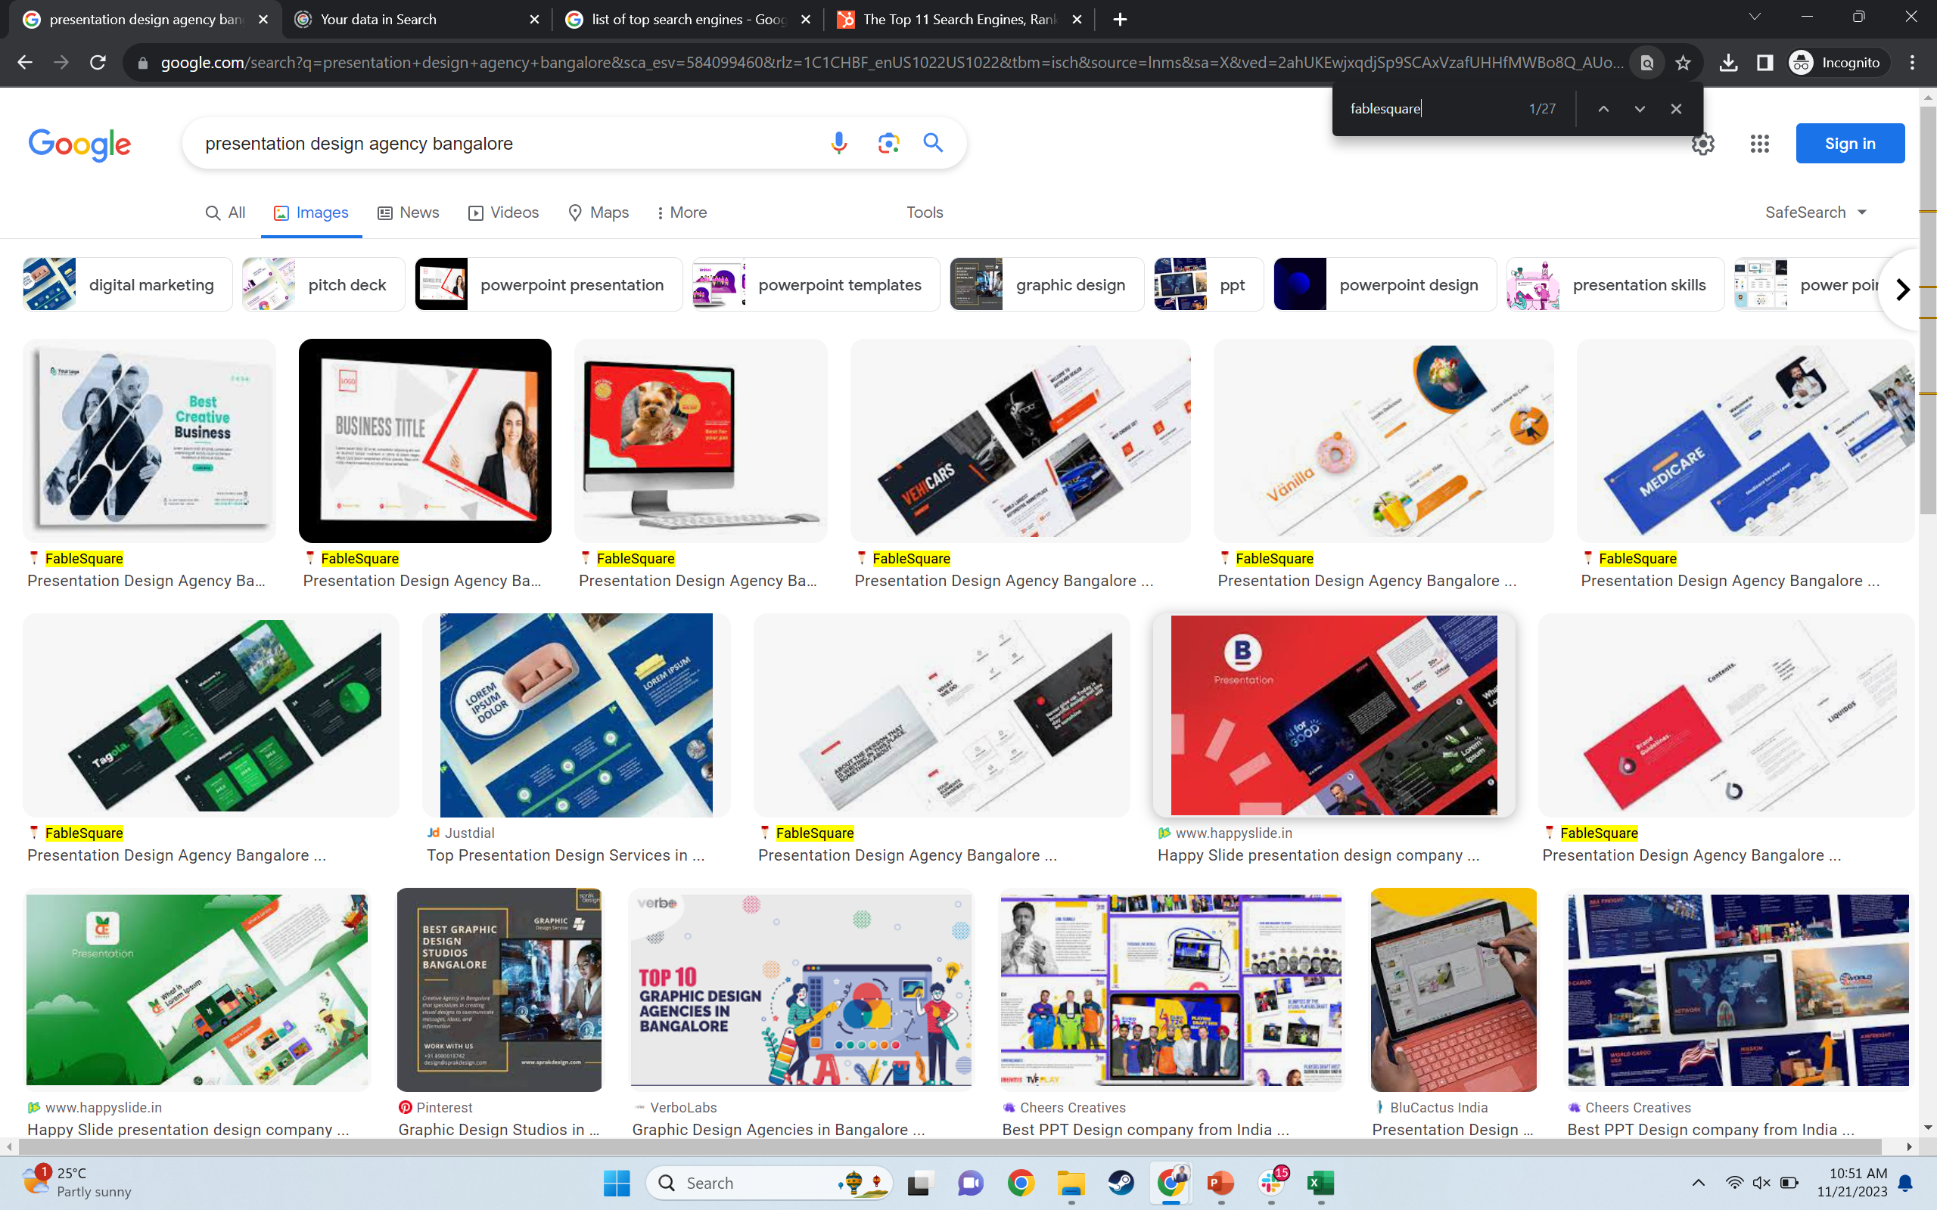

Slide 34
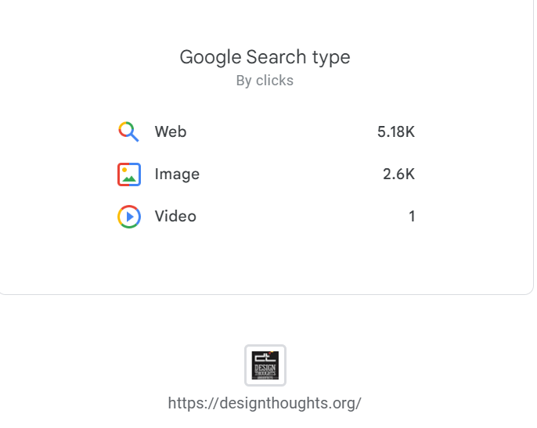
Mayur Bhat
Co - Founder

Slide 35
8. DON'T PUT ALL YOUR
EGGS IN ONE DESIGN​
1
A/B Testing - Test before you decide​
2
Create multiple designs, test them for performance, and choose the best one for optimal result​
3
Practical and data driven method​
4
Allows flexibility in executing marketing strategies​

Slide 36
9. EVERY DROP
MAKES AN OCEAN​
Cumulative effect of small marketing actions on multiple platforms contribute to a larger pool of leads​
Every Source of Traffic Matters
Every source of leads
matters to expand your footprint
*The complete list of activities is available on a spreadsheet at the end of the presentation

Slide 37
10. CONSISTENCY IS KEY​
1
Results get better when done consistently over time
2
Your Brand will have a larger footprint
3
You will have a larger set of assets
4
Law of averages works in your favour

Slide 38
In-house TEAM VS AGENCY
Team
Agency
1
1
High capital investment​
Low investment based on the services availed ​
2
2
No guaranteed return of investment​
Accountability of agencies regarding end results ​
3
3
Influence of interpersonal dynamics on performance​
No relation between the internal affairs and marketing efforts​
4
Creative drainage working on the same business or products​
4
Profound expertise and experience about marketing strategies​
5
Individual experts for the components of marketing ​
6
Highly creative marketing​

Slide 39
Thank you
Mayur Bhat
+91 97313 666 99
mayur@fablesquare.com

